Slide 1




Slide 2
Respond to an RFP
Rex Wong
Professor, Global Health
Director, Bill and Joyce Cummings Institute of Global Health
Director, MGHD
Chair, Innovation Center

Slide 3
I have applied for a grant before
I have received grant before

Slide 4
Overview
Understanding RFP
Writing the proposal
Budgeting
Dos and don’ts

Slide 5
RFP
Formal request to seek proposals for a project or service
Usually includes
  Problem they want to address
  Organization mission
  Requirements
  Evaluation criteria
  Template
  Deadlines
  Information session (webinar)

Slide 6
Understanding RFP – Read
Create a checklist
  Deliverables, documents, deadlines,
  Evaluation criteria
  Mandatory qualifications
  Deal-breakers
  What they look for

Slide 7
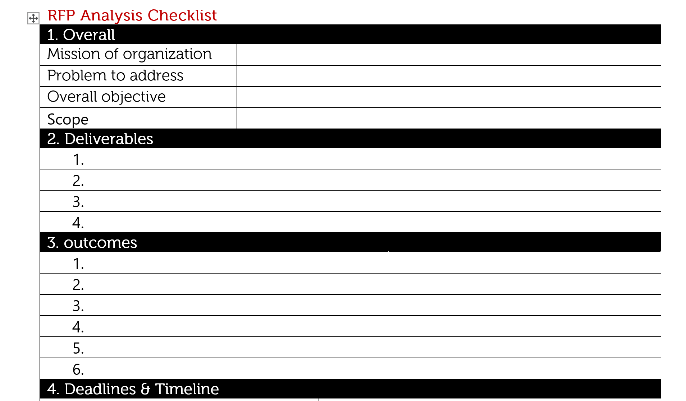

Slide 8
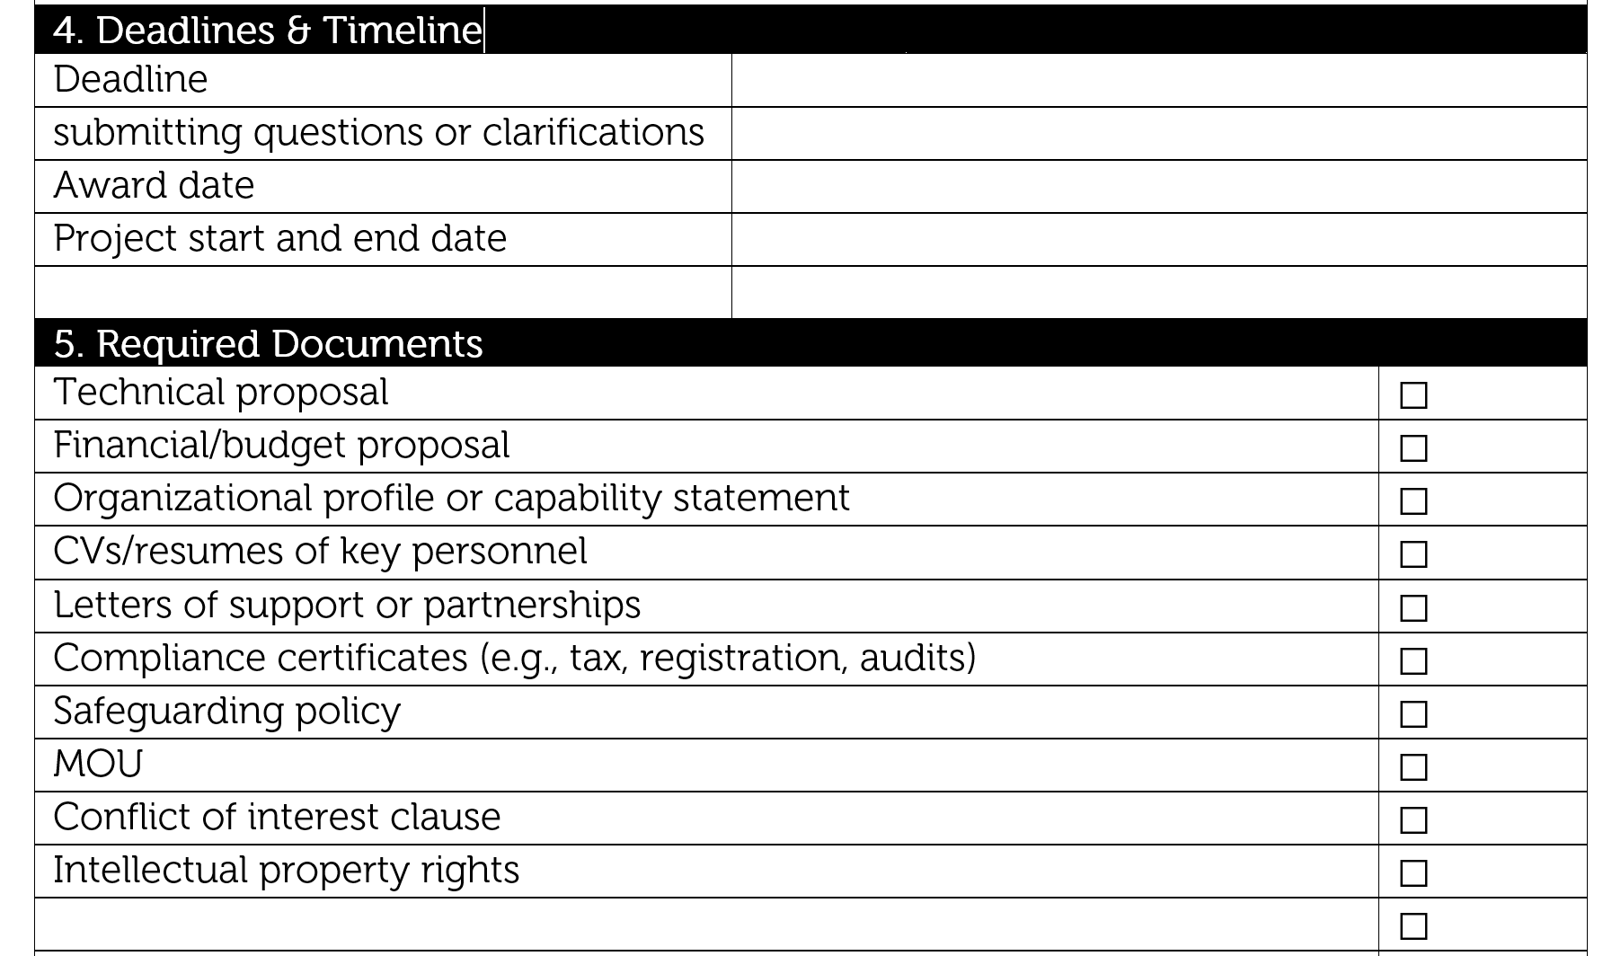

Slide 9
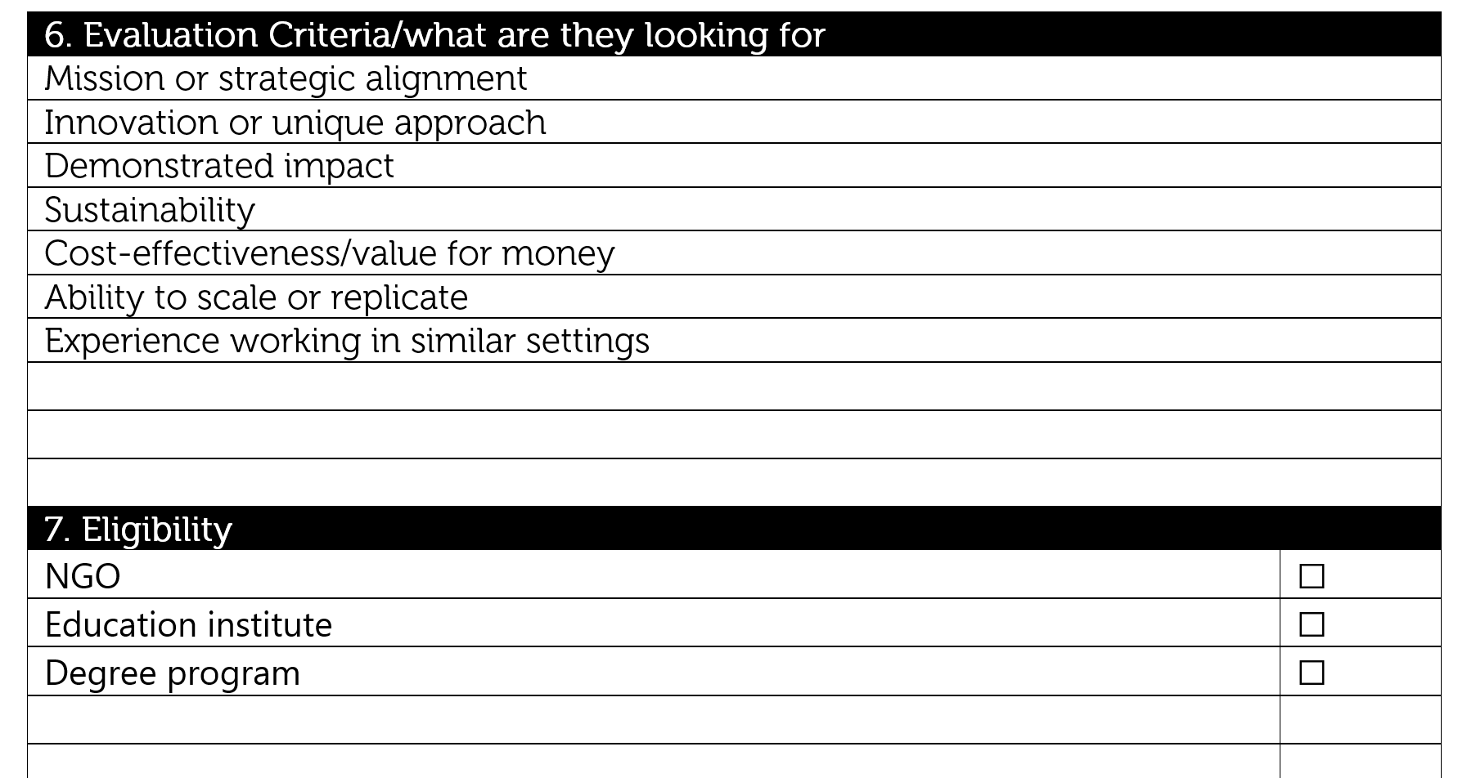

Slide 10
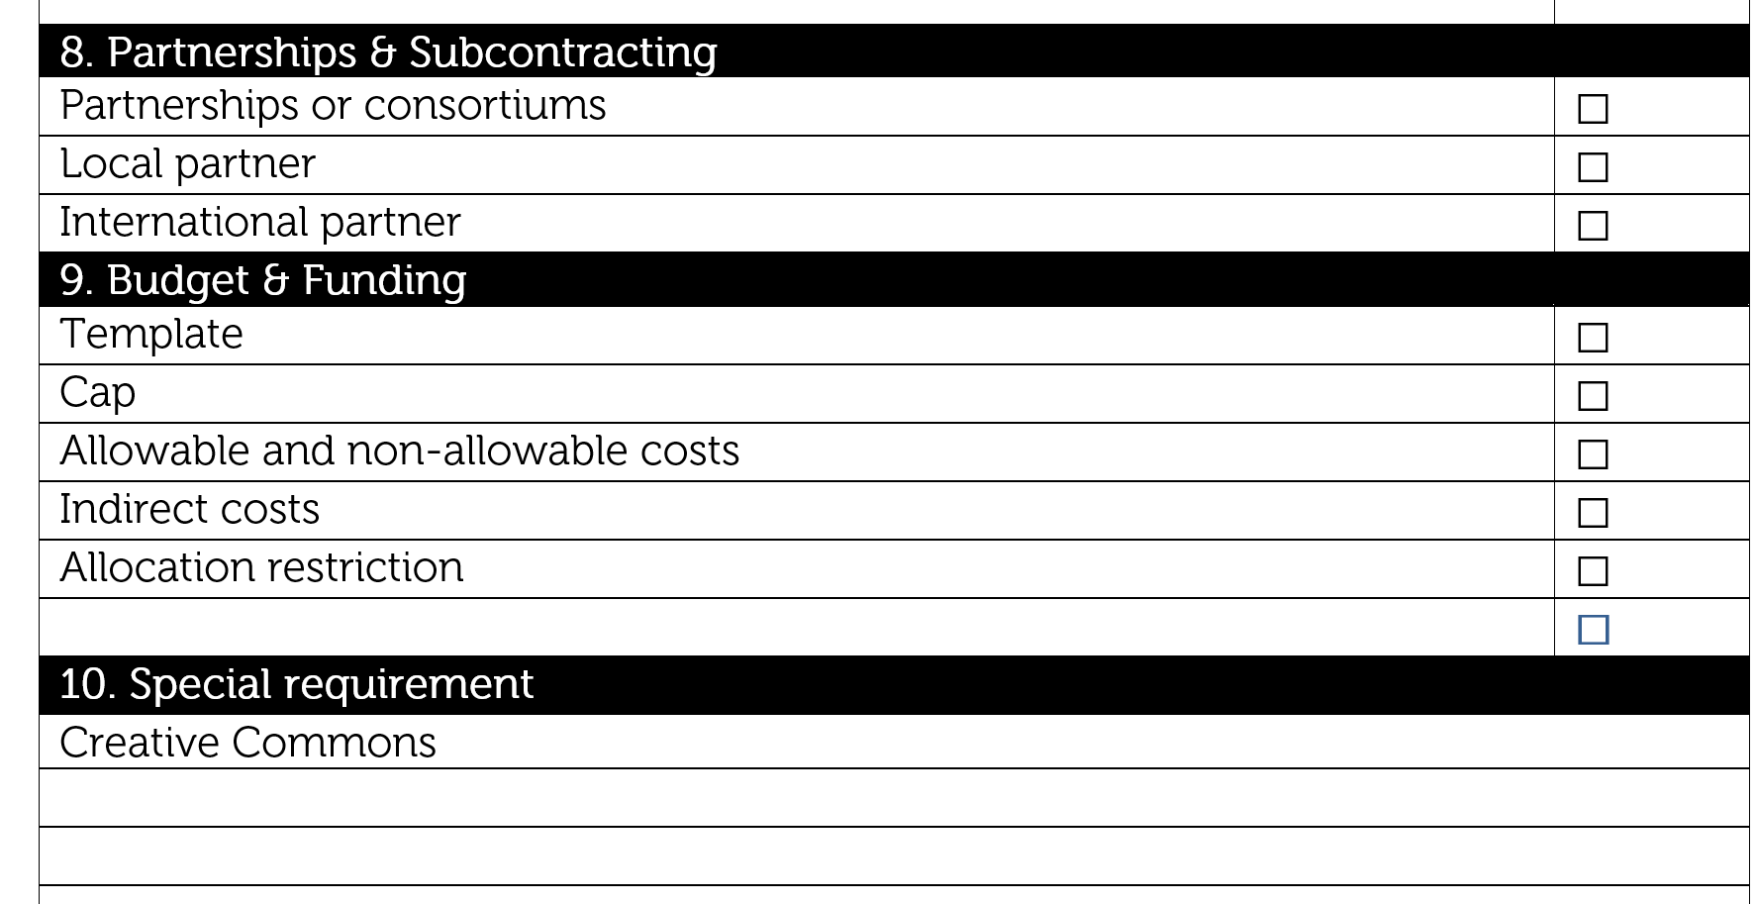

Slide 11
Understanding RFP – Analyze
Check alignment
  Mission
  Expertise
  Scope

Slide 12
Understanding RFP – questioning
Write down questions you have after reading the RFP
Read the FAQ: Many answered in the FAQ
Start writing key points (writing vs thinking)

Slide 13
Understanding RFP – Attend information session
Pay attention to the instructions
Ask questions (only ask questions not mentioned in the RFP)
  Cap
  Allowable items (infrastructure?)
  % of budget allocation (e.g. personnel <15%; overhead%)
  Ask for tips
  What kinds of projects have been funded/rejected in the past?
  Are there specific outcomes or deliverables you expect to see?
  Can you recommend collaboration with other grantees?
  Intellectual property vs creative commons
  How many projects they are going to fund?
  Turn around time
  Are there opportunities for feedback if a proposal is not funded?
  Who typically reviews the proposals (e.g., technical experts, program officers, peer reviewers)?
  A contact person if any questions

Slide 14
Your Response
Follow instruction on the proposal template
  Executive summary
  Proposal: approach, methodology, and timeline
  Team experience: past projects and team qualifications
  Budget: clear and detailed breakdown

Slide 15
Components of executive summary
Four-part formula
First paragraph: personal pitch
  who you are, qualification
  use early success to convince of likelihood of future success
Second paragraph: business pitch
  current situation, needs, solution
Third paragraph: industry summary
  market analysis, competitive advantage
Fourth paragraph: conclusion
  objective, funding support
Notes:
[31] Review 31-34 for details of each section
Introduce business, tell:
1. who you are – the business name (or code name, if yours is a confidential plan)
2. what products or services it focuses on
Identifies customers, tells:
3. which main customer groups your business serves
4. where it is based, where else it has operations and where it sells
Celebrates success, tells:
5. with what success, in terms of revenues and operating margin (operating profit divided by sales), and by which year.
Sell opportunity
[33] how company has maintained competitiveness over time, including in response to any adverse circumstances.
If your business is a new venture, what is your strategy for creating a sustainable competitive advantage in the marketplace you are targeting?
Describe resources
How have the resources deployed developed over time?
Best way to summarize: timeline chart to highlight neatly the main resource-impactful events in the company’s history, e.g. 1. Location and scale of main business infrastructure, e.g. office head- quarters, manufacturing facilities, distribution depots, IT centres, 2. Notable landmarks, such as the one hundredth employee hired, French agent engaged, US subsidiary launched, patents applied for or approved, 3. Acquisitions – of key people, companies, equipment
If start up: Summarize
Where will it be based?
What space will you require,
what physical assets,
how many employees,
what systems?
Who will manage?
http://c.ymcdn.com/sites/ksnurses.com/resource/resmgr/Bus_Plan_for_Nurse_Clinics.pdf

Slide 16
Your idea
Can you describe your product or service in 6 key points or less?
3
4
2
5
1
6

Slide 17
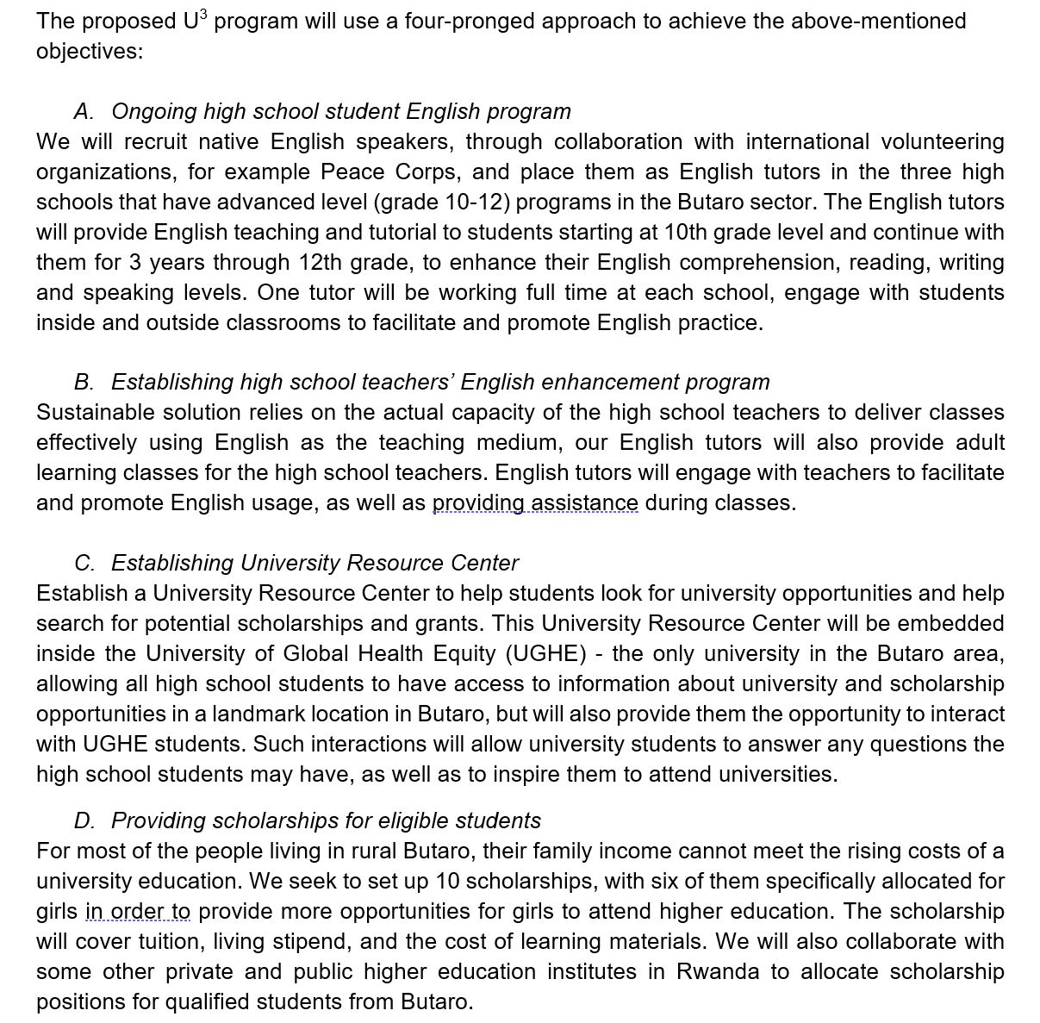

Slide 21
Budget
Align cost items with deliverables
Explain your pricing assumptions
Include optional or scalable items if appropriate
Use their template – be sure to ask questions
Do not go above the cap

Slide 22
Budget
    Common main categories
    Personnel
    Consultants
    Equipment
    Materials & Supplies
    Travel
    Direct cost
    Subcontracts
    Indirect/overhead

Slide 23
Dos
Mirror the funder’s language and priorities (simple language, jargons)
Emphasize relevant experience and value
Clearly categorize and number the information
Proof-read and grammar check
Ensure all required documents are attached
Submit in correct format and by the deadline
Shared documents with the team

Slide 24
Don’ts
Missing the submission deadline
Failing to follow instructions
Submitting a generic or overly technical proposal
Incorrect or unrealistic pricing
Team members working on different versions

Slide 25
Questions?
Rex Wong
rwong@ughe.org

